Slide 1

Ujjwal Gupta guptaujjwal379@gmail.com Galgotias College of engineering & Technology Uttar Pradesh(U.P.) Cyber Security (12/06/2023 – 24/07/2023)

Slide 2

Project Topic
Keylogger Capturing Key strokes

Slide 3
Agenda
To know basic concepts of keylogging
Understand how to capture keystroke from system
To emphasis the process of storing accessed keystrokes into file
To know the implementation of keylogger
Code implementation & python GUI representation

Slide 4

Project Overview
What is Keylogger?
Keylogger is a computer program that captures every keystroke made by a computer user,
to gain fraudulent access to passwords and other confidential information.
Keylogging is also known as Keystroke logging.
It can also be used to study human computer interaction.
There are two basic purpose to use Keyloggers.
To monitor employee performance
To access confidential information

Slide 5

Types of keyloggers
There are different types of Keyloggers divided into two main groups:
Hardware Keyloggers
Software Keyloggers

Slide 6
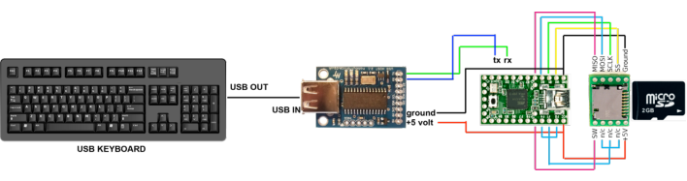
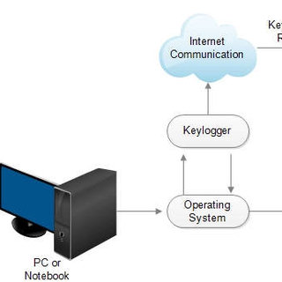
Hardware Keyloggers
Hardware Keyloggers are small electronic devices used for capturing the
data in between a keyboard device and I/O port. Usually these devices have built
in memory where they store the keystrokes so this means they must be retrieved by
the person who installed it in order to obtain the information.
Software Keyloggers
Software Keyloggers track systems, collect keystroke data within
the target operating system, store them on disk or in remote locations,
and send them to the attacker. They can run for an indefinite amount
of time while the info is being transmitted remotely.

Slide 7
Who are end users ?
The keylogger software, in this context, is designed to record and log all the keystrokes made on a computer or device. While keyloggers can have legitimate uses such as monitoring employee activity on company computers or providing accessibility solutions for people with disabilities, they can also be used maliciously for unauthorized surveillance or data theft.
Legitimate end users of a keylogger might include:
Parents
Employers
Accessibility Support
IT administrators

Slide 8
Solution and Presentation
The project statement describes a general situation where a keylogger is capturing keystrokes on a computer or device, which is considered a security threat. To provide a solution, it's essential to know the context in which the keylogger is operating and what specific system or user it targets. The specific solution will depend on the particular circumstances and goals related to the keylogging activity like :
Legitimate Keylogger for Monitoring or Parental Control,
Corporate Network with Keylogger ,
Capturing Malicious Keylogger activity on a Personal Computer .

Slide 9
Project Features
Real-time data process
Privacy - Focused keylogger
Designed as a user education and awareness tool
Secure Password Management
Part of cyber security research
User Experience enhancement

Slide 10
Modelling
The main objective of this project is to capture all the key logs
entered in the system by the user. This can be achieved by using
Software based keylogging method , as by creating a program
using python and its libraries and inject into the system in order
to monitor all its activities like - capturing credentials , personal
information.
Hence the captured keystrokes will get save into a file from where
confidential data can be accessed. The file format used in the project
to store captured keystrokes are .Json & .txt format.

Slide 11

Code Implementation
Code for File. Json type Format

Slide 12

Input

Slide 13


Output
Output for File. Json type Format

Slide 14

Code Implementation
Code for File.txt type Format

Slide 15

Input

Slide 16

Output
Output for File. txt type Format

Slide 17
Results
The outcomes of keylogger system can be diverse, depending upon objective’s and goals of the working system potential outcomes can be observed :
It can be helpful in identifying security vulnerabilities in software, operating systems, or websites.
This system successfully detects anomalous user behavior patterns that could indicate security breaches.
The keylogger project effectively helps users manage their passwords securely.
It consider the potential long-term impact of the keylogger, both positive and negative, on users, organizations, and security practices.

Slide 18
Links
https://www.javatpoint.com/creating-a-keylogger-using-python
https://www.codelivly.com
https://www.studocu.com/in/document/
https://cybercademy.org/
GitHub link : https://github.com/Ujjwal379/Keylogger-Capturing-Keystrokes.git

Slide 19
THANK YOU

